Slide 1
CLIP
Contrastive Language-Image Pretraining

Slide 2
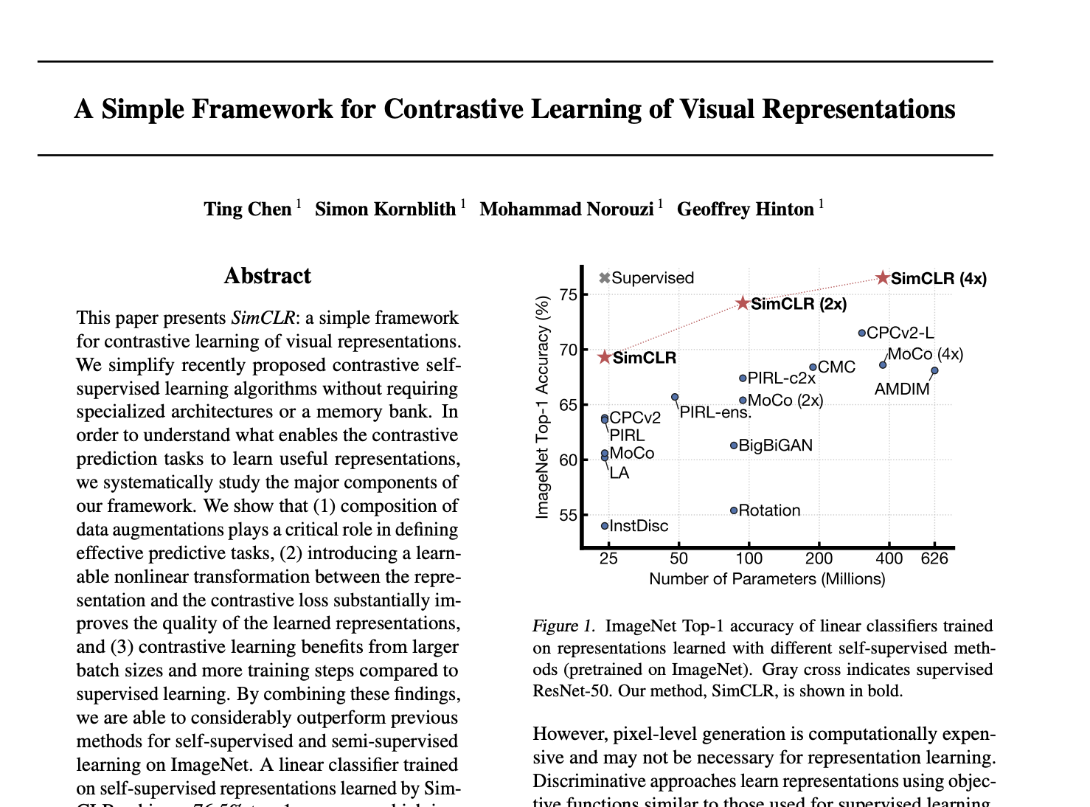
SimCLR

Slide 3
SimCLR
A Simple Framework for Contrastive Learning of Visual Representations
Google Research
https://arxiv.org/pdf/2002.05709.pdf
Key Questions
How do we learn visual representations from unlabeled images?
Can we apply learned representations to new problems?
Prior Work
Generative (Autoencoder & GANs)
Discriminative (Patch Prediction, Augmentation Prediction)

Slide 4
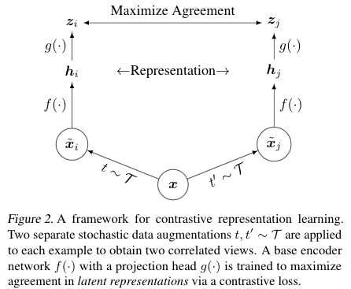
Big Idea
Latent
Loss Function
Projection
Encoder
Input
Augmentation 1
Augmentation 2

Slide 5
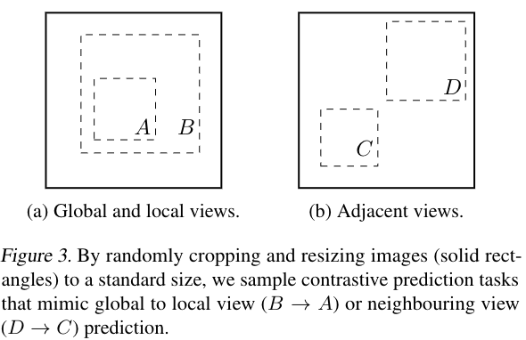
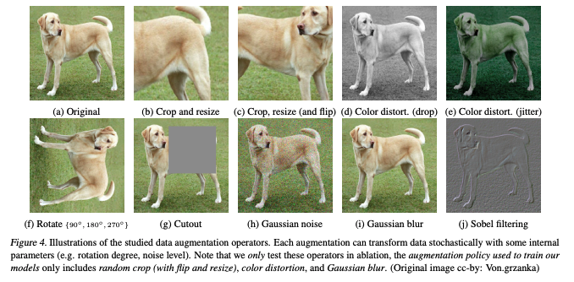
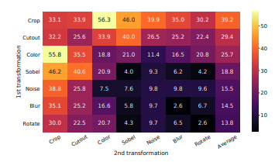
Augmentation
Random Crop
Global to Local
Color Distortion
Networks learn color
No perfect combination

Slide 6
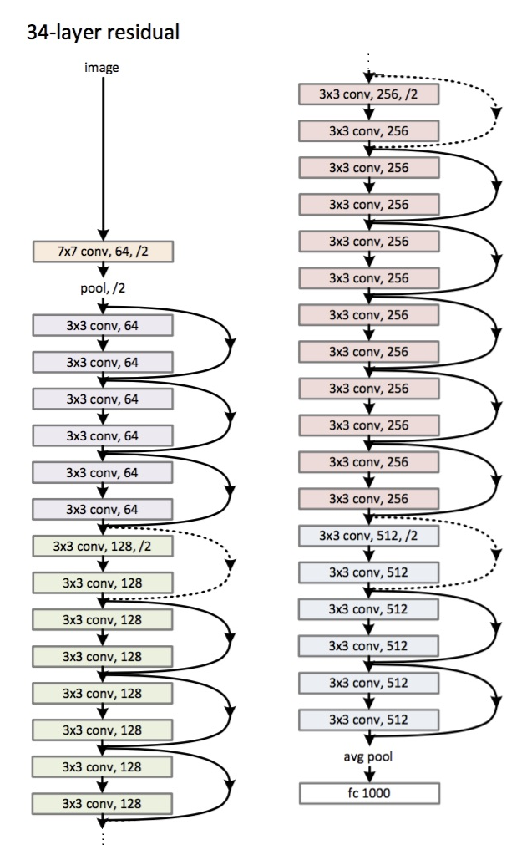
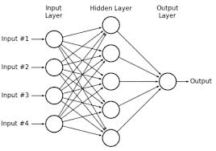
Encoding & Projection
ResNet is used to encode images
1 Layer Non-Linear Dense (ReLU)

Slide 7
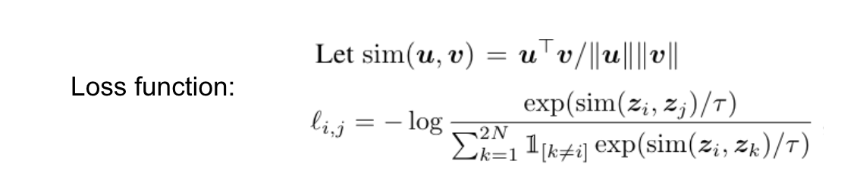
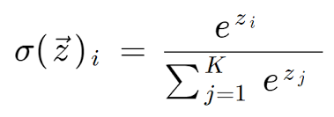
Loss
Cosine Similarity
Temperature
For each Positive Pair
Softmax

Slide 8

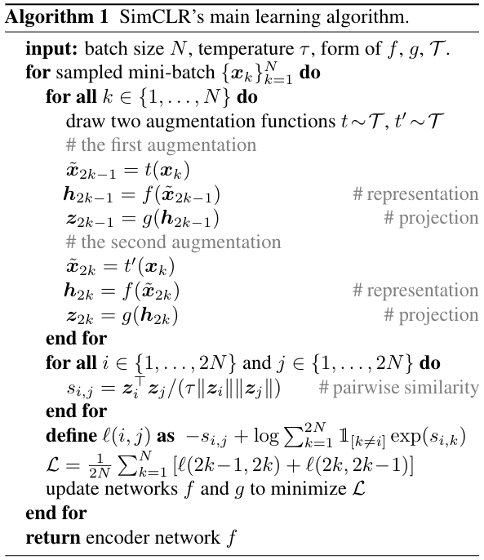
Algorithm

Slide 9
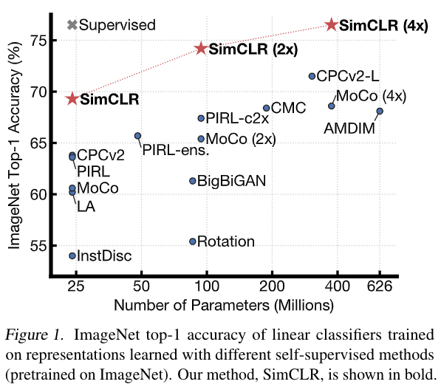
Results

Slide 10
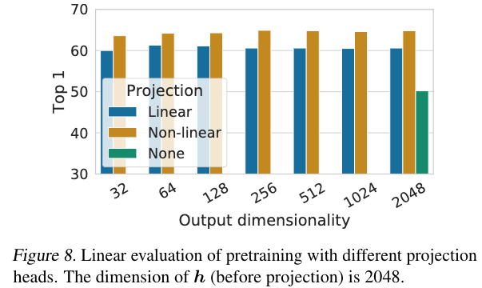
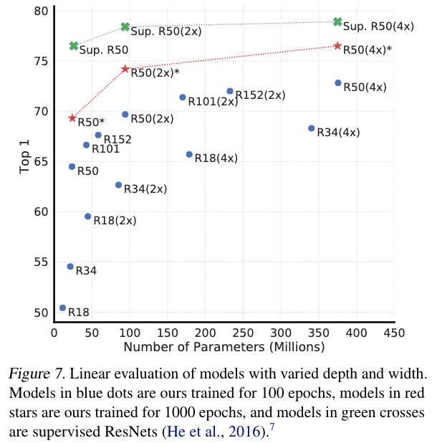
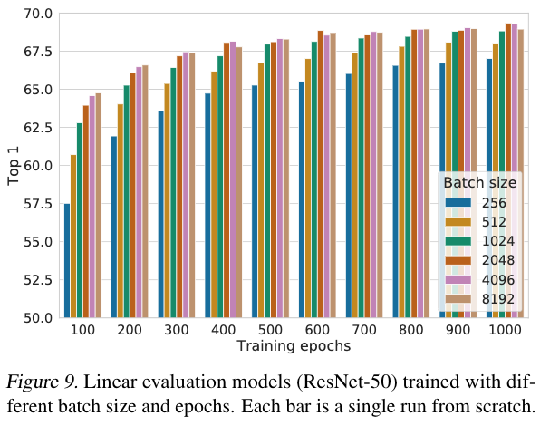
SimCLR Findings

Slide 11
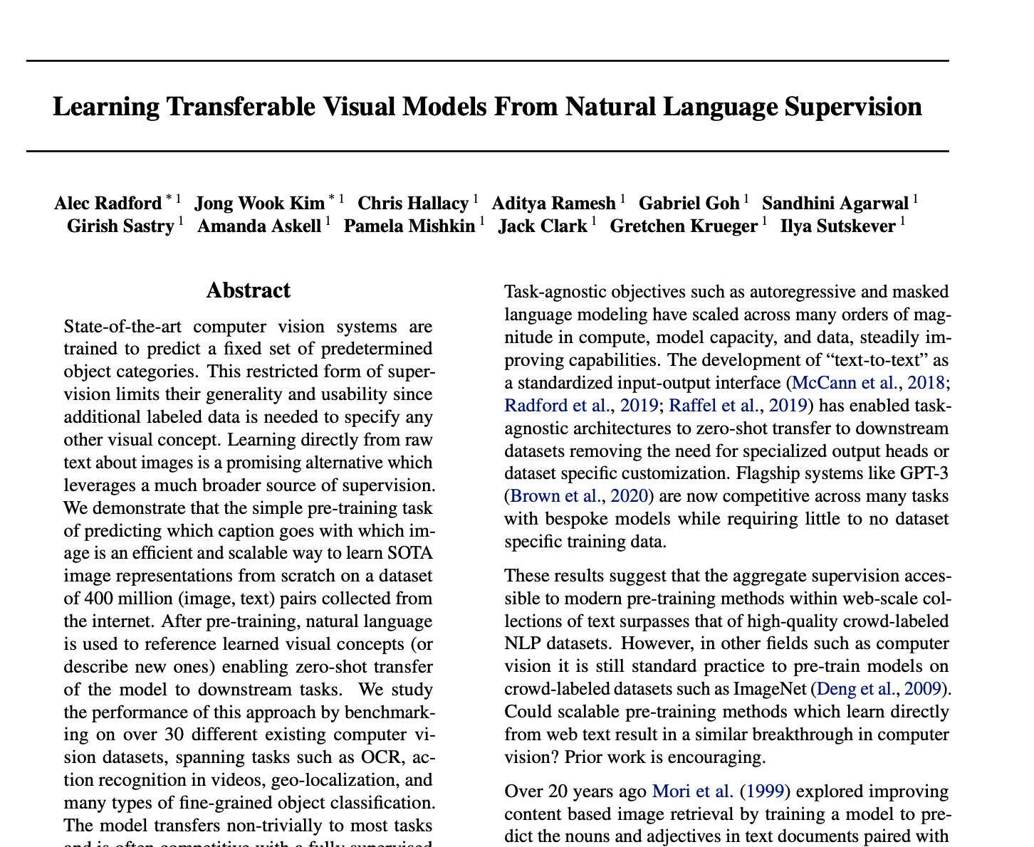
CLIP

Slide 12
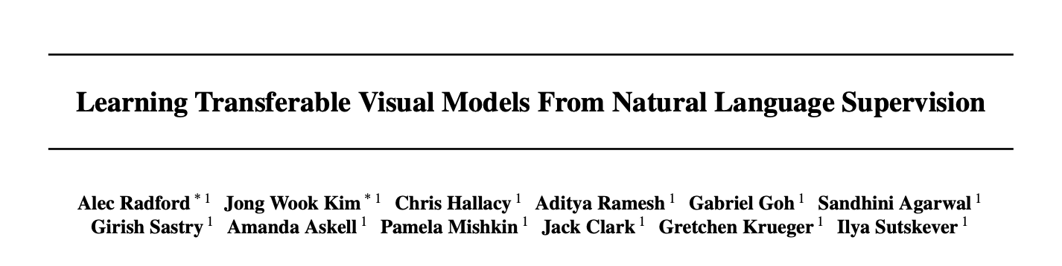
CLIP
Learning Transferable Visual Models From Natural Language Supervision
OpenAI
https://arxiv.org/pdf/2103.00020.pdf
Key Questions
Traditional SOTA computer vision trained to predict predetermined categories
Expanding is limited by lack of labeled data (Expensive)
Can a model learn SOTA matching which caption matches with photo?
Can that model help downstream tasks?
Prior Work
SimCLR
Image Resnet / ViT
Transformers

Slide 13
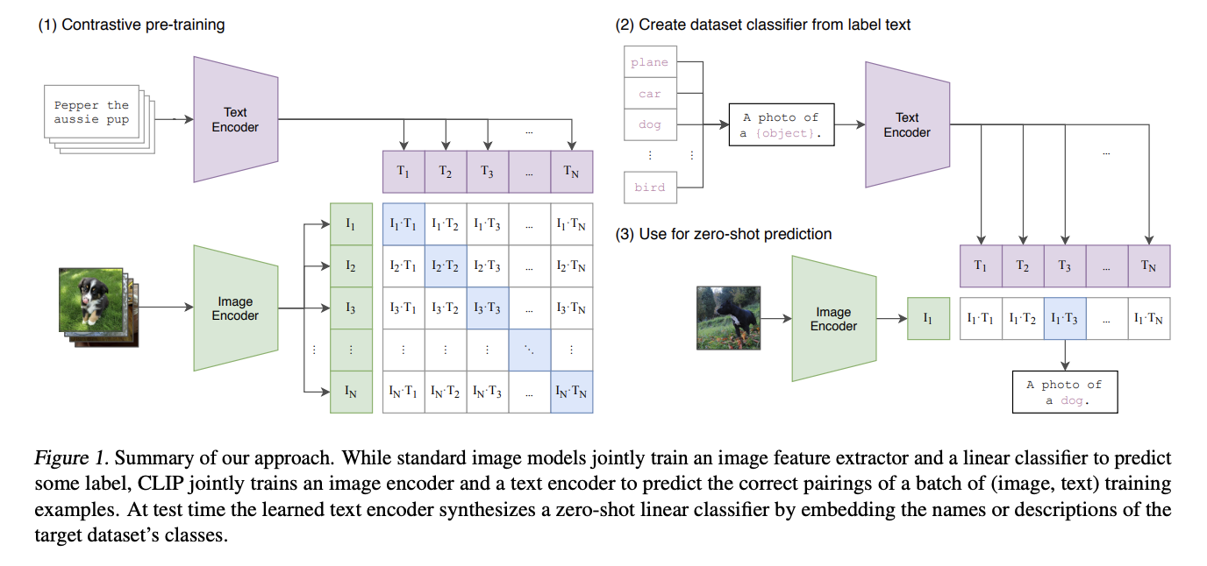
CLIP

Slide 14
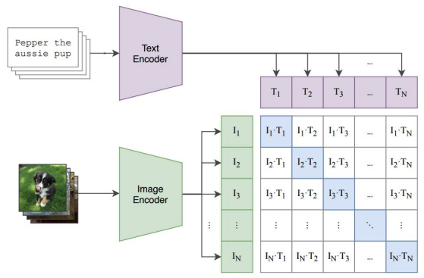
CLIP
Jointly Train
Text Encoder
Image Encoder
To Predict
Correct Pairings
Of Batch of Image / Caption Pairs
At Test Time
Synthesize classes into a Zero Shot Classifier
By Embeding the class name in the Target Dataset Classes

Slide 15
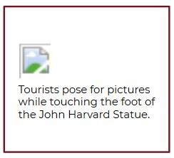
Training Data
Existing Datasets
MS-COCO – 100k
YFCC100M – 100M
Mahajan 2018 – 3.5B Insta
Images with Text / Captions
Only 15M YFCC100M has useable file name
15M is around size of ImageNet
Constructed 400 MM Images
Query 500,000
Query
Occurred 100 times in Eng Wikipedia
Augmented with bi-grams
Class Balance up to 20k images / query
Dataset similar word count as GPT-2 <Scaling!>

Slide 16
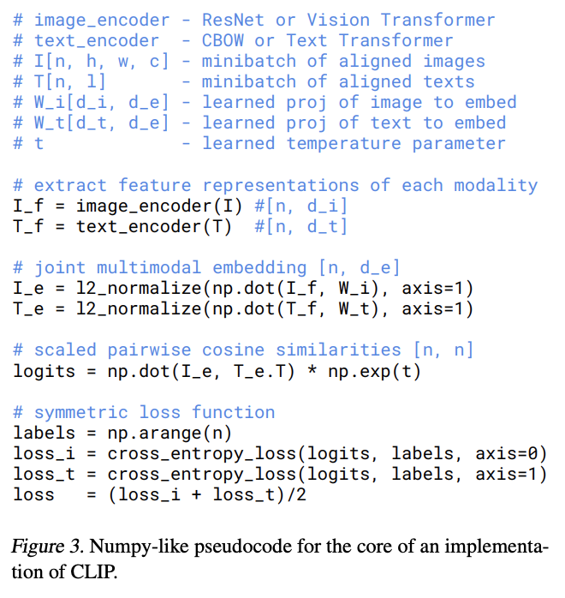
Algorithm
Batch Size = 32,768
Epochs = 32
Learning Rate Decay = Cosine
Vision Encoder
- ViT
- ResNet
Text Encoder
- Transformer

Slide 17
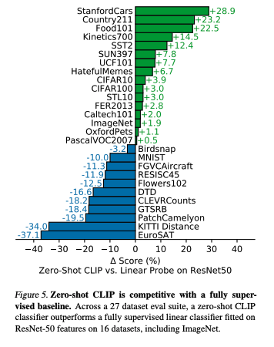
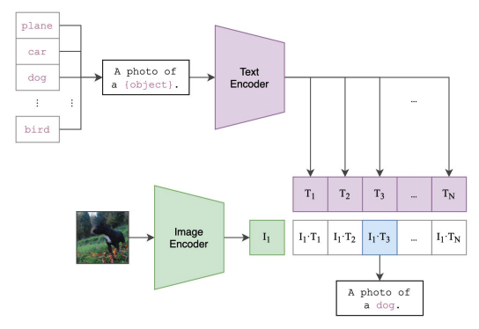
Zero-Shot Classification

Slide 18
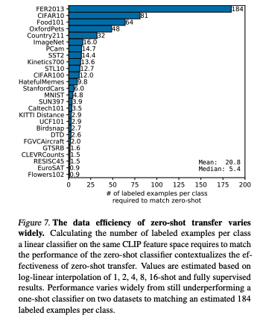
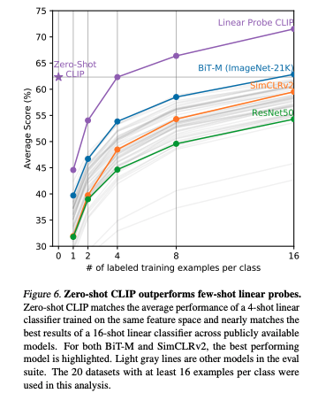
Few Shot vs Zero Shot

Slide 19
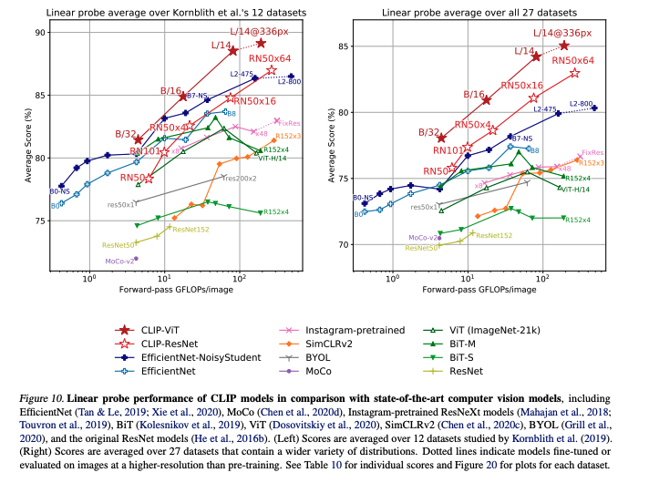
Comparing Models

Slide 20
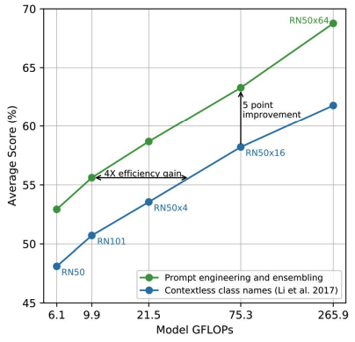
Prompt Engineering
Text classifiers can be challenging
Labels are noisy
Polysemy (Bank, Boxer, Crane)
Prompt Engineering
Template “A photo of a {label}”
Helped by adding category
A photo of a {label}, a kind of pet
Adding “a type of {category}
Quotes around text helped some
“A satellite photo …” helped
Ensemble Prompts
They build 80 different prompts
Ensemble results of prompts
Average Results
Foreshadowing

